Slide 1

LagerSYNC
Vid Brložnik, Tilen tratnik and Florjan peric

Slide 2



Introduction
LagerSync is a web application designed to improve lumber transport organization between private forest owners, SIDG, and truck drivers.
Our goal is to reduce empty truck trips, improve communication, and make transport more efficient.

Slide 3
The problem
Truck drivers often transport partially filled loads
Poor communication between forest owners, Slovenian State Forests, and drivers
Last-minute cancellations waste time and fuel
Manual coordination is inefficient

Slide 4

Our solution
Centralized web application for all stakeholders
Combines nearby loads to fill trucks
Real-time messaging and notifications
Reduces costs, emissions, and empty trips

Slide 5
Key features
User registration and role-based access
Add and browse transport requests
Advanced filtering (location, date, volume)
Accept transport jobs
Internal messaging
Reports and feedback

Slide 6
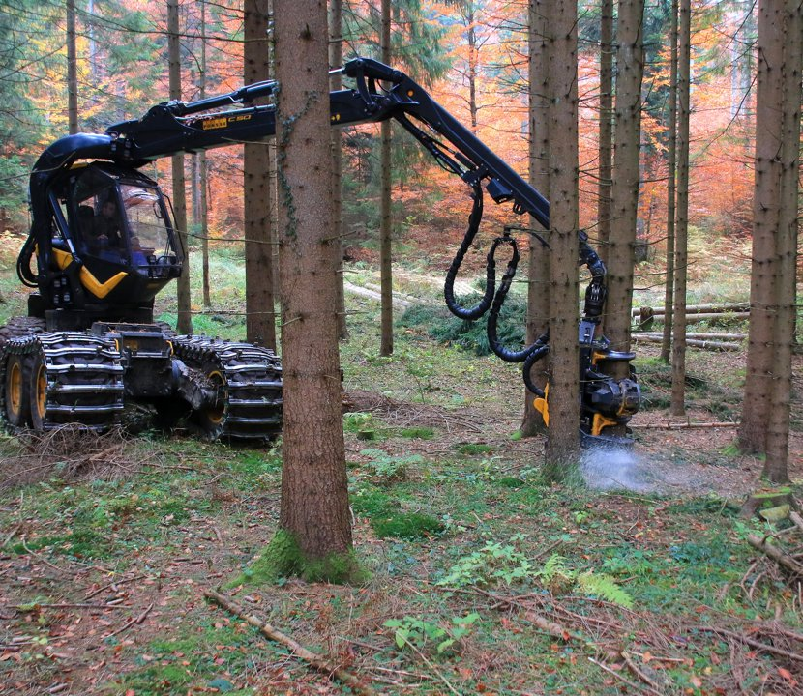


User needs
Truck Drivers
Forest owners
SIDG
Fully loaded trucks
Fewer cancellations
Better route planning
Easy transport ordering
Delivery notifications
Transparent communication
Centralized oversight
Easier coordination
Activity reports

Slide 7



Technologies used
Frontend: HTML, CSS, JavaScript
Backend: Node.js + Express.jsDatabase: MySQL
Tools: Figma, Jira, GitHub

Slide 8
Testing and Results
Conducted usability tests with 3 users
Main issue: filtering system was confusing
Users requested clearer interface and tooltips
Core functionality worked successfully

Slide 9

Conclusion
LagerSync solves a real logistics problem in the forestry sector
Improves efficiency and communication
Reduces costs and environmental impact
Prototype demonstrated strong potential for real-world use

Slide 10

Thank you

